Slide 1
Manitoba School Bus Pre-Trip Inspection
A PowerPoint Presentation Supporting the School Bus Pre-Trip Inspection Instructional Video

Slide 2
Now that you have viewed the school bus pre-trip inspection video, this presentation will:
Enhance what you have just viewed.
Further explain how to check components on the bus to ensure they are working correctly.
Highlight areas of the video that were difficult to illustrate – i.e. acceptable condition defects and out-of-service condition defects.
Provide an opportunity to discuss specific requirements relevant to your school division or employer.
Provide an opportunity for Q & A.
Notes:
NOTE TO DRIVER INSTRUCTOR
You may choose to use this PowerPoint presentation for:
Enhancing the pre-trip video.
Providing further explanation in checking operation of school bus components to ensure they are working correctly.
Expanding on defect criteria. What is an acceptable condition defect versus an out-of-service condition defect as outlined in the Manitoba School Bus Inspection Log Book?
Inserting specific instruction according to school division/employer requirements.
Review and discussion.

Slide 3
Part of being a school bus driver is your responsibility to understand the different components of each make and model of school bus you will operate.

Slide 4
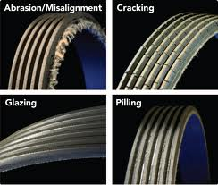
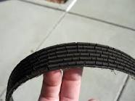
Engine Compartment Checks
Check and grab drive belts for tension, cracks, and wear.
Notes:
NOTE TO DRIVER INSTRUCTOR
Instructor must mention to the trainee about verbalizing what they are looking for when being tested by MPI.

Slide 5
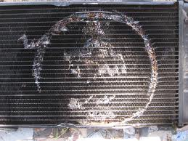
Engine Compartment Checks
Check radiator for security.
Inspect the brackets and supports.

Slide 6
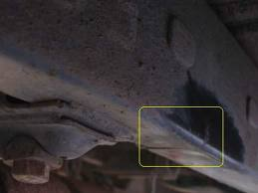
Engine Compartment Checks
Check the cross members and frame rails for bends or cracks.

Slide 7
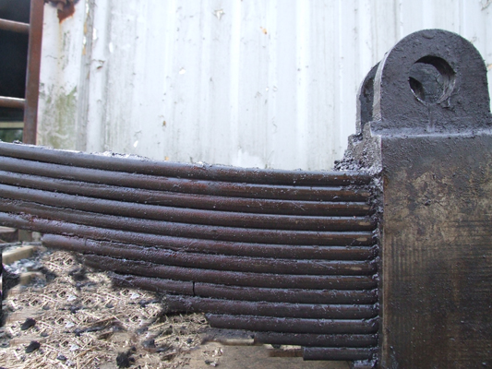
Engine Compartment Checks
When checking leaf springs, either front or rear, look for cracks, shifting, and missing or broken parts.
Crack

Slide 8
Engine Compartment Checks
While inspecting in the engine compartment, check all components for wear, security, or defects (e.g. air filter, compressor, alternator, starter, etc.).
Notes:
NOTE TO DRIVER INSTRUCTOR
Explain the different components of each make and model of school bus.

Slide 9
Outside Bus Checks
As you first approach the school bus to begin the pre-trip inspection, check the front licence plate – is it missing? loose? damaged?
As you move around the bus, check reflective tape, licence plate light, hazard lights.
Notes:
NOTE TO DRIVER INSTRUCTOR
Elaborate on tire tread depth needing to be 3.2 mm for front tires, and 1.6 mm for rear tires. Instructor must mention to the trainee about verbalizing the tread depth on front and rear tires when being tested by MPI.

Slide 10
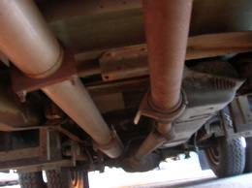
Outside Bus Checks
While looking at the underside, check frame rails and cross members for cracks and bends.
Example of
drive shaft
failure.
Notes:
NOTE TO DRIVER INSTRUCTOR
Instruct trainee to mention these items when being tested by MPI.

Slide 11
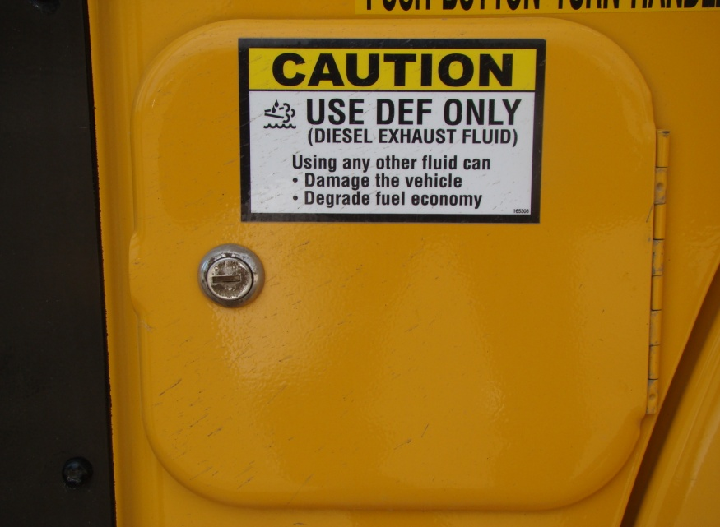
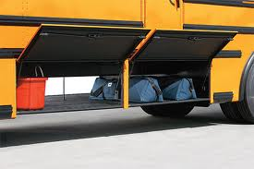
Outside Bus Checks
All doors or covers must be secure and closed.

Slide 12
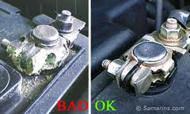
Outside Bus Checks
Check batteries for security, loose connections, and corrosion.

Slide 13
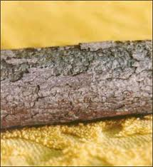
Outside Bus Checks
Fuel tank brackets must be checked for security.
Check fuel lines for leaks.

Slide 14
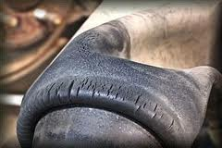
Outside Bus Checks
When checking air ride suspension, look for cracked or deflated air bags.

Slide 15
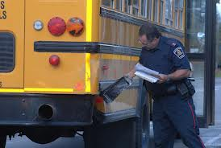
Outside Bus Checks
Ensure bumpers are secure by physically checking for looseness and damage.

Slide 16
Inside Bus Checks
There are a large number of components to check from inside the school bus. Some can be checked while the key is on; others will require that the engine is running.
Notes:
NOTE TO DRIVER INSTRUCTOR
Instructors will need to discuss each component and its operation as it relates to particular makes and models (e.g. wipers/washers, door operation, heaters/defrost and controls, mirrors, interior lights, etc.).

Slide 17
Inside Bus Checks
Several safety devices will incorporate audible signals (buzzers). Understand and listen for signals from roof hatch, rear door, and emergency side window operation.
Interior conditions are important to the safe operation of the school bus. A thorough inspection checks for clutter, loose items, and general cleanliness .

Slide 18
Hydraulic Brake Check &
Park Brake Operation
Ensure you are familiar with hydraulic service brake and park brake checks for the makes and models of school buses you will operate.
Understand brake warning indicators (lights and audible indicators).
A service brake and park brake check must be performed during a pre-trip inspection.
Notes:
NOTE TO DRIVER INSTRUCTOR
Instructor will need to explain hydraulic service brake and park brake checks for the numerous makes and models of school buses.

Slide 19
Hydraulic Brake Check
Visually inspect warning systems and listen for audible signals.
Apply and maintain moderate foot force to the service brake pedal for one minute. The pedal should not move towards the floor more than 65%.
Engage a forward gear, release foot pressure allowing the bus to move forward slightly and reapply foot pressure, ensuring the bus stops.

Slide 20
Park Brake Operation
To test the park brake system: While applied, select a forward gear; release the service brake; ensure the park brake holds the bus without movement.
Some buses are not capable of gear selection while the park brake is applied. These buses will require slight forward movement before the park brake can be applied. This action should stop the bus.
Do not accelerate in order to test the park brake while applied.

Slide 21
IN SUMMARY
Knowledge
of Bus Features
+
Understanding How Bus Operates
+
Thorough
Pre-Trip Inspection
=
A Safe Bus To Transport Children

