Slide 1

Be Safe !
Follow
School Bus
Safety Rules
Prepared by:
Pupil Transportation Unit
Manitoba Education and Training
Notes:
The information contained in this presentation provides students with school bus ridership knowledge to help them stay safe. Once students have a sound knowledge of how to ride the school bus, they are provided the SAFEST MEANS OF TRAVEL TO AND FROM SCHOOL. The notes accompanying each slide provide teachers with information and ideas to assist with delivering this message.
Suggested Discussions With Students:
How many of you ride the school bus every day?
At some point you will probably all ride in a school bus – maybe on a field trip or to a basketball game. It is important that everyone know school bus safety rules.
Do you know all the rules to safely ride the school bus?
School Bus Facts For Teachers:
Yellow and black colours were selected to make the school bus most visible.
School bus drivers use signal lights, brake lights, and amber pre-warning lamps to notify drivers that the bus is preparing to stop. The RED loading lights flash brightly side to side when the school bus has stopped and the entrance door is opened.
The STOP sign(s) automatically extends from the side of the bus when the entrance door opens. The STOP sign is also equipped with flashing lights.
A yellow crossing arm is located on the front bumper of the bus. It also extends when the entrance door opens, and is designed to prevent children from crossing too closely to the front of the bus where the school bus driver may lose sight of them.
The school bus mirror system, a raised driver’s seat, and clear site lines give the school bus driver a “vantage point” to monitor vehicle traffic. The school bus driver is best able to monitor vehicular traffic for dangerous situations.

Slide 2


Be Safe !
Follow School Bus Safety Rules
WHAT IS SCHOOL BUS SAFETY?
Not reaching under the bus!
Being careful in the DANGER ZONES!
Getting to the bus stop
Crossing roads
Getting on and off the bus
Behaving on the bus
Notes:
BUSTER the Safety Cat is a well-known mascot associated with school bus safety.
School bus safety begins when students leave their homes in the morning and ends when they return safely at the end of the day.
Suggested Discussion Questions:
What do you do if you drop something under the bus?
Do you know the DANGER ZONES around the school bus?
How do you get to and from the school bus stop safely?
How many of you have to cross the road to get to the school bus stop?
How many students get on the school bus at your stop?
How do you behave on the school bus?

Slide 3
Be Safe !
Follow School Bus Safety Rules
You are taking your friend’s birthday card to school. It’s a windy day and the card blows out of your hand and underneath the school bus. You know you shouldn’t reach for it, but you really want to save your card!
What should you do?
Notes:
Can students identify what they should and should not do?
The following slide sends the message that students should NEVER reach under the school bus to retrieve something they’ve lost.

Slide 4

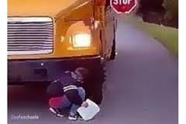
Be Safe !
Follow School Bus Safety Rules
NEVER REACH FOR ANYTHING UNDER THE SCHOOL BUS !!
Notes:
STRESS THIS MESSAGE TO STUDENTS:
NEVER REACH FOR ANYTHING UNDER THE SCHOOL BUS! The school bus driver will not be able to see you. Instead, leave it there and tell your bus driver what has happened, or tell the teacher who is supervising in the loading area, or another adult nearby. They will know what to do to safely retrieve what you’ve lost under the bus.

Slide 5
DANGER
ZONES
Notes:
School division transportation reviews conducted by the Pupil Transportation Unit have consistently found that grades 4 and 5 students are unclear which areas around the school bus are the most dangerous. Ensure students have a very clear understanding of this topic before proceeding further.
All areas around the school bus are dangerous. Students must be particularly mindful to the area three metres all the way around the school bus. It should be noted that the areas behind, and to the left side of the bus are not considered to be “as dangerous” because students should NEVER be in those areas.
The MOST DANGEROUS zones are those directly in front of the school bus and along the right rear side.

Slide 6
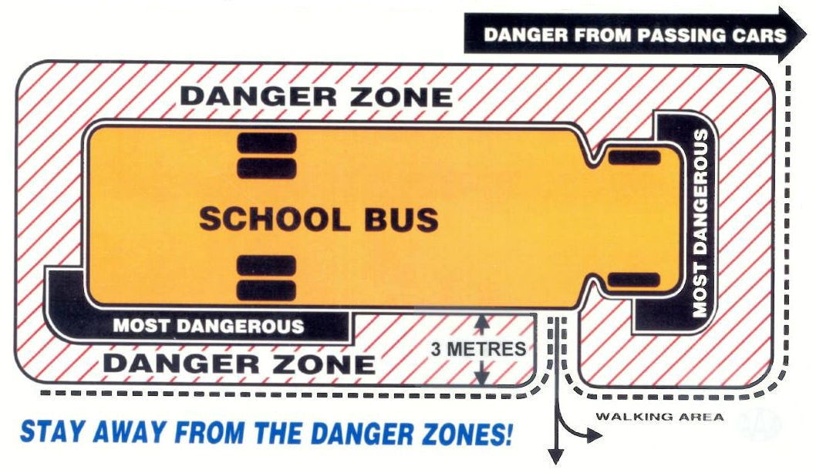
SCHOOL BUS DANGER ZONES
Notes:
The MOST DANGEROUS zones are those directly in front of the school bus and along the right rear side.
Why is the FRONT OF THE SCHOOL BUS so dangerous? Because the school bus is so high, the driver may not see students who are crossing too closely in front of the school bus. The extended crossing arm on the front of the bus encourages students to cross far enough ahead of the bus that the driver can see them.
Why is the RIGHT REAR SIDE OF THE SCHOOL BUS so dangerous? The danger comes from students slipping or being pushed under the bus out of the driver’s view and being run over by the right rear wheels. Students must be particularly careful and respectful of this area of the bus.
NEVER WALK ON SNOWBANKS! Students could loose their footing and slip beneath the wheels of the bus.

Slide 7

Be Safe !
Follow School Bus Safety Rules
THE
SCHOOL BUS STOP
Notes:
Suggested Discussion:
When we walk anywhere, there are lots of things we need to do to make sure we are safe.
Discuss getting to the bus stop on time, and what to do (and not do), once they have arrived.
If students must cross a roadway to get to the bus stop, the following slides outline how to do so safely.
Stress that walking in front of the bus, ahead of the extended crossing arm, allows the school bus driver to see them, and helps keep them safe.

Slide 8
Be Safe !
Follow School Bus Safety Rules
The School Bus Stop:
Be on time – get to the bus stop as much as five minutes early.
Don’t crowd or push others who are waiting at the bus stop.
Stay off the road.
Look out for each other! Show respect. Bullying someone is unacceptable.
Notes:
It is suggested that students arrive at the bus stop as much as five minutes early. School buses try to be on time, but sometimes they may be a little early. Students should allow themselves enough time to get to the bus stop so they are not running towards the school bus, are not anxious about getting on the bus, or taking risks to board the bus.
While waiting for the school bus, students shouldn’t play around or be pushing or shoving each other. Someone could fall into the path of the oncoming bus or other vehicle, or get hurt in some other way. Students should always stand in a safe location, away from traffic. Stay off the road.
When boarding the bus, students should line up in single file, youngest to oldest. This order allows older students to assist younger students to board, or help monitor younger students’ actions. School buses have very high steps. Younger students are typically carrying a lot of personal items (e.g. backpacks, lunches, books, or toys) or are dressed for winter conditions which limits their mobility. With an older student behind a younger student, slips and falls may be avoided while entering the school bus. Students entering the school bus in a calm and orderly fashion helps keep everyone safe.
It is important that students look out for each other, and respect each other. Bullying is not to be tolerated.

Slide 9
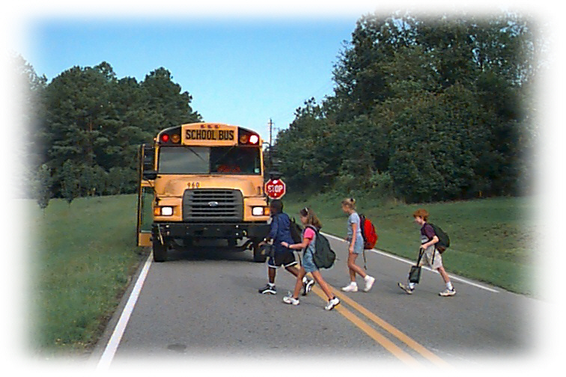
Be Safe !
Follow School Bus Safety Rules
Crossing the Road TO GET TO THE SCHOOL BUS STOP
Notes:
School divisions make every effort to load/unload students on the right side of the bus for safety reasons. However, in some circumstances students may have to cross the road which increases the risk of hazards.
Suggested Discussion:
How do you get to the school bus stop if you have to cross the road?
You should always wait for the school bus to arrive before crossing the road. School buses have features that will help you get safely across the road. What are some of these features?
1. The school bus is large and very bright yellow. ONLY a school bus can be this colour.
2. The school bus has lots of lights. These lights tell other drivers they must stop because you need to cross the road to get to your school bus stop.
3. The school bus has a STOP sign with red flashing lights that swings out from the side of the bus. Some school buses have two stop signs with red flashing lights.
4. The school bus driver has lots of mirrors to see cars behind the bus. The school bus driver is sitting up high so he/she can see cars coming from either direction.
The school bus has a crossing arm on the front bumper that swings out in front of the bus. This prevents you from crossing too closely to the front of the bus where the driver can’t see you.
NEVER go underneath or jump over the extended crossing arm!

Slide 10
Be Safe !
Follow School Bus Safety Rules
Crossing the Road to Get to the School Bus Stop:
Don’t cross the road until the school bus arrives.
Watch for the bus driver’s signal that it’s safe to cross.
Look left, right, and left again for traffic.
When safe, walk straight across the road – not on an angle. Walk quickly, but don’t run.
Notes:
Students who must cross the road should wait for the bus to arrive. The school bus driver, as well as the special equipment and flashing lights on the school bus, will help the student cross the road safely. The school bus driver can see when all traffic has come to a complete stop. Students should watch for the school bus driver’s signal that it is safe to proceed across the road.
Students need to double-check that it is safe to cross the road after receiving the school bus driver’s signal. “Look left, right, and left again before crossing the road.”
Stress the importance of crossing the road at a right angle and with reasonable walking speed. A reasonable walking speed limits students’ exposure to vehicular traffic.
Don’t run. Students could trip and be injured, drop their belongings, or run into another student.
Discussion Question: What signal does your bus driver use?

Slide 11
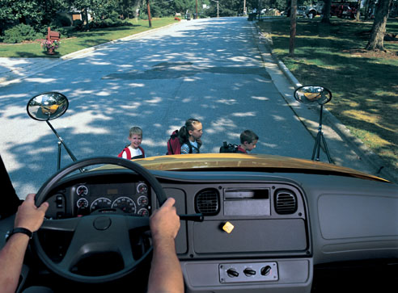
Be Safe !
Follow School Bus Safety Rules
Crossing the Road to Get to the School Bus Stop:
Cross the road in front of the school bus and ahead of the extended crossing arm.
NEVER cross the road BEHIND the school bus !!
Notes:
This picture shows the school bus driver’s view when children cross ahead of the extended crossing arm (the crossing arm is not visible in this picture).
Stress to students that crossing closer to the front of the bus hides them from the bus driver’s view and puts them in extreme danger.

Slide 12
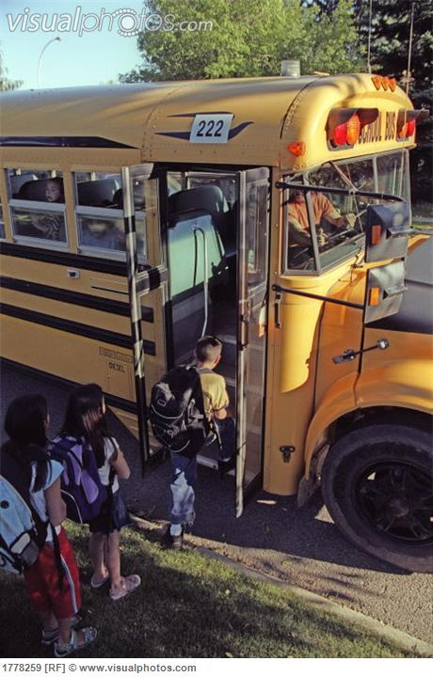
Be Safe !
Follow School Bus Safety Rules
Getting on the SCHOOL Bus
Notes:
Possible Discussion Questions:
When you are at the bus stop, how do you get on the bus safely?
Do you ever rush up to the door of the school bus while it is stopping?
Do you ever push and shove to get on the bus first?
Can you get a better seat if you get on the bus first?

Slide 13
Be Safe !
Follow School Bus Safety Rules
Getting on the School Bus:
Line up single file with younger students at the front.
Wait until the door is fully open, then board quickly and safely. Always use the handrail.
Don’t run onto the bus. Be careful getting on the bus if you are carrying anything.
Go directly to your seat. Face forward.
Place anything you are carrying on your lap or on the floor at your feet.
Notes:
Review why younger students should get on the bus first (slide #8).
Students should wait at least three metres away from the bus and make sure it has stopped completely before moving towards it. Students could get hurt if the bus were unable to stop in time, or if it were to lose control on ice or in slippery conditions.
The school bus door opens outwardly. If students are too close to the bus they could get hit by the door as it opens.
When climbing the steps of the bus it is very important to hold onto the handrail. The handrail is designed for all ages of students and will help them climb the steps safety, particularly when they are slippery from water, dirt, or ice. Carry-on items should be held in one arm and use the other hand to hold onto the handrail. Be aware of loose drawstrings on jackets and straps on backpacks, etc. as they could get caught on the handrail.
Most school buses have assigned seating – “that means a seat that is yours to use all the time. There is no need to rush onto the bus for a better seat because you already have a seat assigned to you.”
Carry-on items should be placed on the student’s lap or on the floor at their feet. Backpacks, books, or other items should never be placed in the aisle where someone could trip over them.
Additional Instructor Information:
School buses don’t have SEAT BELTS! School bus seats are designed and built in a special way so that passengers don’t have to use seat belts. Seats are close together and are made with very thick padding. They are also very high. This design is called COMPARTMENTALIZATION. Compartmentalization is very much like an egg carton used to transport eggs. A well-fitted, confined, soft surrounding that keeps passengers securely in place is the best way to transport students without the use of seat belts. Stress to students the importance of sitting forward when the bus is in motion.

Slide 14
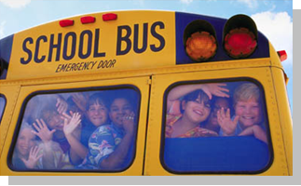
Be Safe !
Follow School Bus Safety Rules
BehavING
on THE
SCHOOL Bus
Notes:
Discussion Questions and Suggested Responses:
How should you behave on the school bus?
For safety reasons, students are expected to behave the same way they do in the classroom. The school bus is an extension of the classroom. Misbehaving on the school bus can be distracting to the school bus driver which could take his or her attention away from driving safely.
Can you move around on the school bus?
No, moving around on the school bus should not happen. Students are typically assigned a seat on the bus which they should stay in at all times.
If students are moving around in the bus they are not safe in an accident situation. The seats can only protect students when they are seated properly (facing forward, personal items stored on their lap or at their feet, sitting completely on the seat). If a student is standing in the aisle, turned around in his/her seat, or moving around when the bus hits a bump, has to stop quickly, or is involved in an accident, the student could be injured because they were not seated properly.
Can you be loud on the school bus?
No, students should never shout or yell on the school bus. This can distract the driver. The driver may think the student is in need of help. If the driver is having to look in the interior rear-view mirror to see what is going on, he or she is not watching the road.
Can you do whatever you want when you are on the school bus?
No, students cannot behave any way they want. The school bus driver will report their actions to the school principal. The principal is ultimately in charge of students’ behaviour on the school bus. It is important that students listen to the school bus driver because he or she is in charge while they are on the bus. BUT, serious problems will be handled by the principal.

Slide 15
Be Safe !
Follow School Bus Safety Rules
Behaving on the School Bus:
Unless there is an emergency, never touch the emergency door!
Don’t eat or drink on the bus.
Always listen to your bus driver’s instructions.
If you have a school bus captain, listen to his/her instructions too. They also help keep you safe.
Remember: The school bus driver is the boss of the bus!
Notes:
Suggested Discussion With Students:
There are a lot of emergency exits on the school bus including emergency doors, emergency windows, and emergency roof hatches.
UNLESS THERE IS AN EMERGENCY, NEVER touch the emergency exit handle on the doors, windows, or roof hatches!
All emergency exits are connected to buzzers and lights. If you play with an emergency handle, the driver will hear a buzzer or see a light that tells them you are playing with the handle. The driver can look in the mirror and see who is playing with the emergency handle and you will get into trouble. By doing this, you have also taken your school bus driver’s eyes off the road.
Eating and drinking on the school bus is not allowed. If you are eating or drinking on the bus you could choke or become sick and the driver may be unable to see that you are in trouble. The driver can’t help you if he or she can’t see you. Remember the bus has very high seats! Someone who is choking usually gets down or bends over making it even harder for the driver to see someone in trouble.
THE SCHOOL BUS DRIVER IS THE BOSS OF THE BUS! It is important that you listen to his or her instructions and follow the rules.

Slide 16
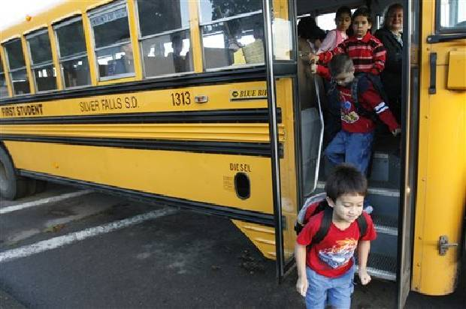
Be Safe !
Follow School Bus Safety Rules
Getting Off
THE
sCHOOL Bus
Notes:
Procedures for getting off the school bus are very similar to getting on the school bus. There are, however, a few extra things to remember.

Slide 17
Be Safe !
Follow School Bus Safety Rules
Getting Off the School Bus:
Stay in your seat until the bus has stopped.
Always use the handrail when getting off the bus.
Look to your right when getting off the bus.
Be extra careful in the DANGER ZONES.
Move quickly away from the bus to a safe location.
Notes:
Students may want to exit the school bus quickly to get to school, get home, or to meet up with friends, but they must remain seated until the bus has stopped.
Students should not run down the steps. They should always hold onto the handrail.
In rare instances, a motorist may attempt to pass the stopped school bus on its RIGHT side – the same side students exit the bus. Students should look to their right as they get off the bus, just to make sure it’s safe.
Once students are safely out of the bus, they should move quickly to a safe place - e.g. onto the sidewalk or into the school.

Slide 18

Be Safe !
Follow School Bus Safety Rules
CROSSING The Road After getting Off THE school Bus
Notes:
Getting off the bus and crossing the road requires one more step than crossing the road to get to the bus stop. The next slides explain how students should stop in an area in front of the bus, look left, right, and left again before crossing the road.

Slide 19
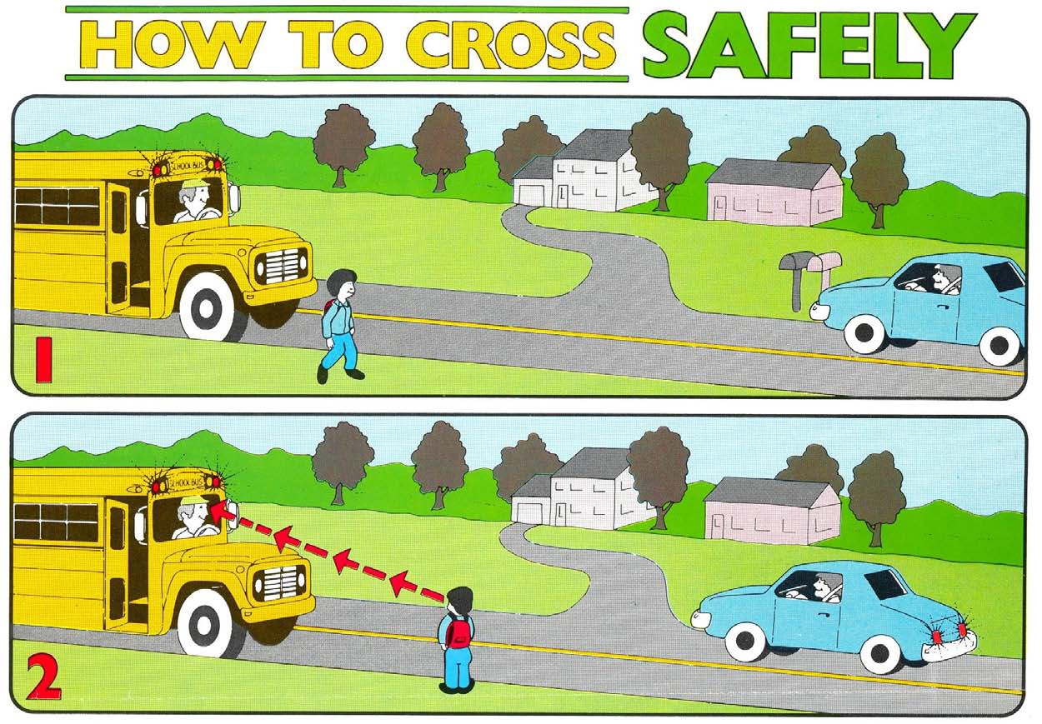
Be Safe !
Follow School Bus Safety Rules
Crossing the Road After Getting Off the Bus:
Take three giant steps away from the bus.
Walk along the edge of the road until you are ahead of the extended crossing arm on the bus.
Stop and wait for the bus driver’s signal that it’s safe.
Notes:
The diagram on the next slide will reinforce the first steps for getting off the bus and crossing the road.

Slide 20
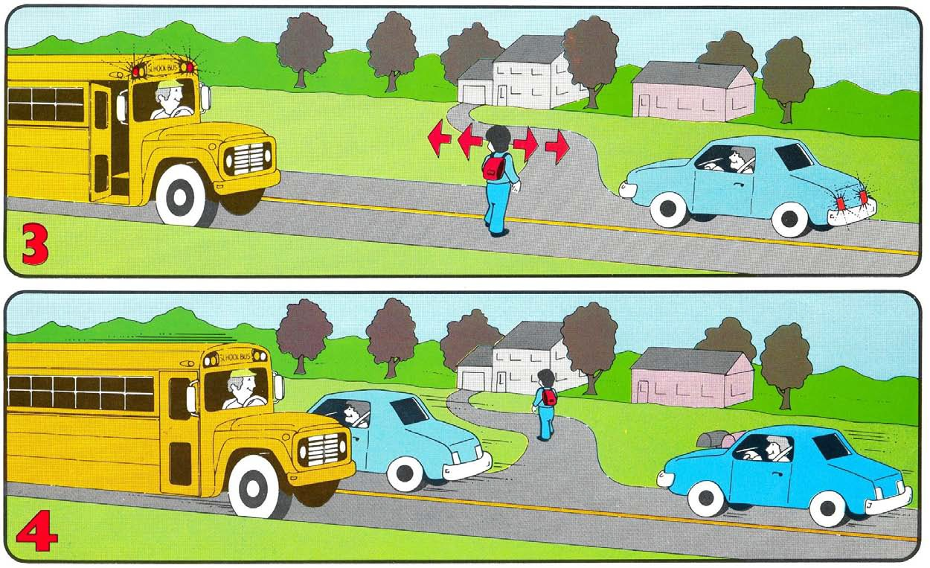
Be Safe !
Follow School Bus Safety Rules
Crossing the Road After Getting Off the Bus:
Proceed to the left front corner of the bus and stop.
Look left, right, and left again before stepping out beyond the protection of the school bus.
Walk quickly (don’t run) until you are fully and safely off the road.
Notes:
The diagram on the next slide will reinforce the final steps for crossing the road after getting off the school bus.
Review Questions: Do you remember how many giant steps you take once you get off the bus? (Answer: Three).
Do you remember why we walk ahead of the extended crossing arm? (Answer: Being too close to the front of the bus puts students in extreme danger of the driver not seeing them.

Slide 21

Be Safe !
Follow School Bus Safety Rules
Think back . . .
Do you remember our talk about school bus DANGER ZONES? Where are the MOST DANGEROUS zones around the school bus?
Notes:
Of all the school bus safety rules, one of the most important is for students to understand the danger zones around the school bus. To ensure they remember the discussion you had earlier, the next slide is meant for review, and shows the MOST DANGEROUS areas in a slightly different way.

Slide 22

THE FRONT OF THE SCHOOL BUS
AND THE
RIGHT REAR SIDE OF THE SCHOOL BUS ARE THE
MOST DANGEROUS ZONES.

Slide 23
Be Safe !
Follow School Bus Safety Rules
YOU HAVE LEARNED SOME
VERY IMPORTANT
SCHOOL BUS SAFETY RULES TODAY.
DO YOU HAVE ANY QUESTIONS?
Notes:
Answer any questions students may have regarding the rules learned or reviewed so far.
Suggested Additional Discussion
If you chose to, you may use the following two slides as additional information in your ridership training. They pertain to illegal passing of school buses.
Illegal passing of school buses involves vehicles passing a stopped school bus (either from behind or oncoming) that has its red loading lights flashing and the stop arm extended in order to load or unload students. Illegal passing is an increasing problem everywhere. If convicted of this offence in Manitoba, a driver can face a substantial fine and loss of merit points on their driver’s licence. Worse than the legal consequences however, such actions could end a child’s life.
This is a very “mature” topic, but due to its increasing incidence, it is suggested that students of all ages be made aware of it. Students should know of the requirement for motorists to stop for a school bus, and also know that some drivers won’t stop. Students must be provided with the information necessary for them to play an active role in their own safety.

Slide 24
Be Safe !
Follow School Bus Safety Rules
THERE IS ONE MORE THING YOU SHOULD WATCH OUT FOR.
SOMETIMES GROWN-UPS ARE IN A HURRY OR ARE THINKING ABOUT SOMETHING ELSE . . .

Slide 25
Be Safe !
Follow School Bus Safety Rules
. . . and they forget to stop when you are getting on or off the school bus. This could also happen when you are crossing the street in front of the bus.
WATCH FOR CARS PASSING
YOUR SCHOOL BUS!!
Notes:
Illegal Passing of School Buses Vehicles
The wording in this slide is geared towards younger students. You may choose to re-write the message for older students, and draw the conversation to a close with the message “Expect the Unexpected!”

Slide 26
Be Safe !
Follow School Bus Safety Rules
“ EVERY TIME YOU ARE NEAR A SCHOOL BUS
BE AWARE,
BE CAREFUL,
BE SAFE !! “

