Slide 1
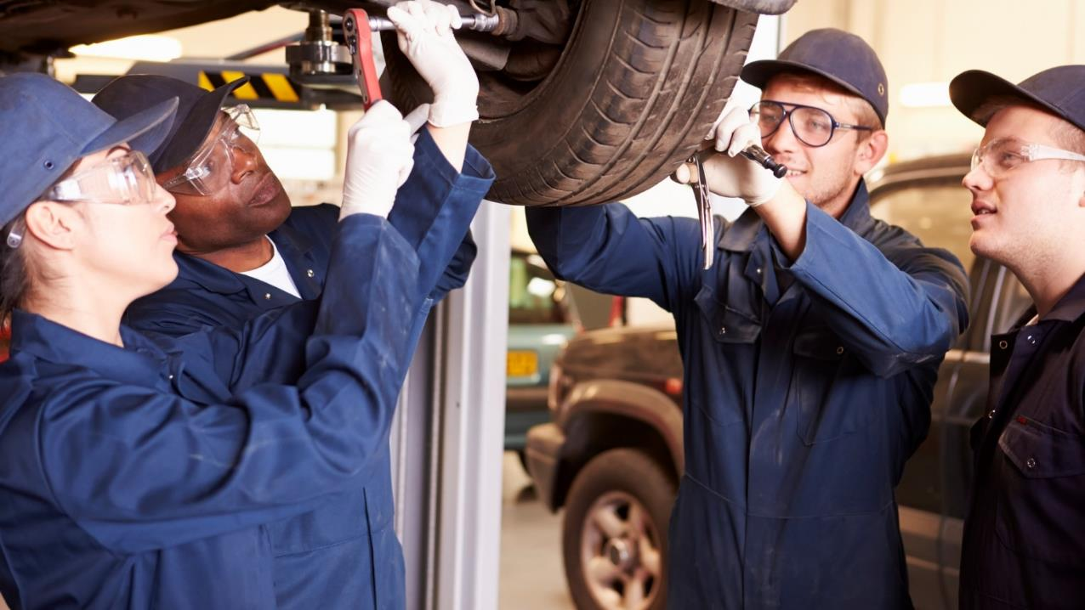
High School Apprenticeship Program
HSAP

Slide 2
Notes for HSAP Educators
These slides are intended as a promotional resource to accompany the content in the HSAP Educator, Student, and Employer guides. You may wish to re-organize and add slides and videos in order to meet your local needs.
To increase engagement, you may wish to ask students to guess the trades depicted in the images in this presentation, using the Manitoba trades page as a reference.

Slide 3
Which trades are depicted in this presentation?
https://www.gov.mb.ca/wd/apprenticeship/discover/mbtrades/index.html

Slide 4
The High School Apprenticeship Program (HSAP) is a pathway for students in Grades 10–12 to explore an apprenticeable trade while completing their academic graduation requirements.

Slide 5
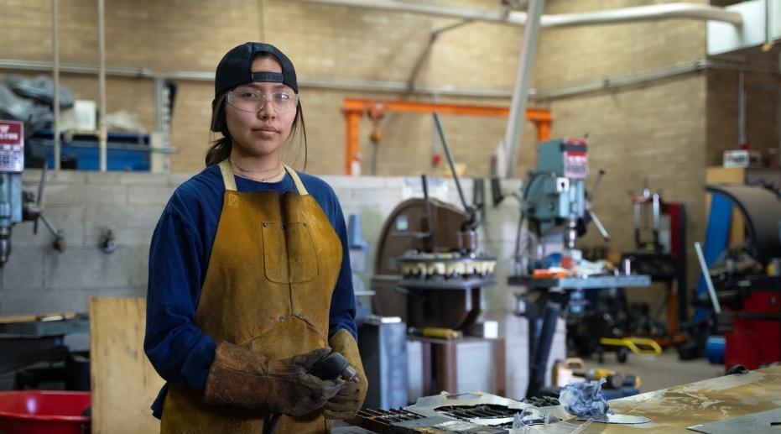
LEARN A SKILLED TRADE AS AN APPRENTICE.

Slide 6
A SKILLED TRADE is a career path in hands-on work with specialized knowledge and skills.

Slide 7
Why pursue a trade?

Slide 8
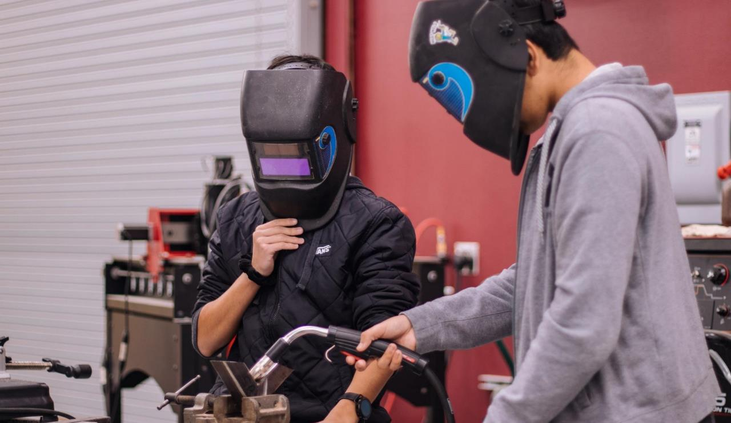
WORK WITH
YOUR HANDS, HEAD, AND HEART.

Slide 9
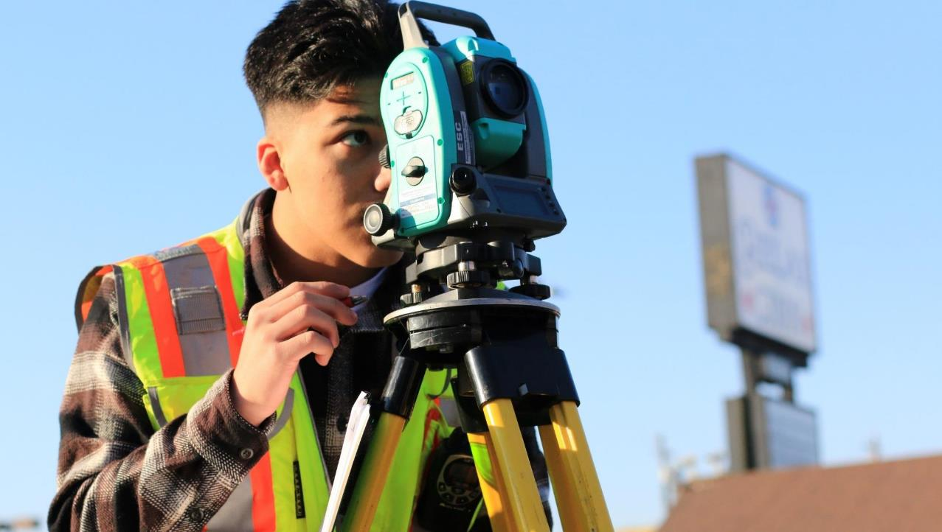
PROBLEM SOLVE.

Slide 10
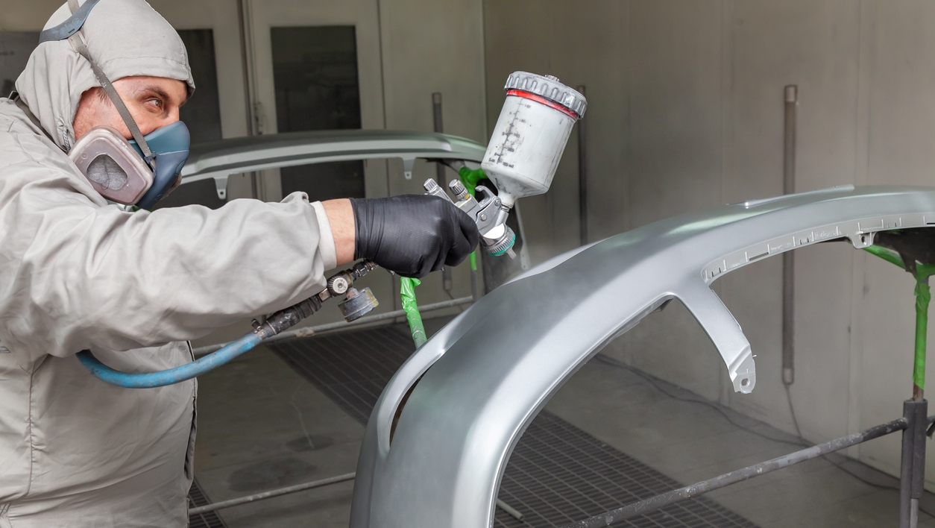
GAIN
SATISFACTION.
Build, create, repair, and supply a service.

Slide 11
LEARN NEW
TECHNOLOGICAL
SKILLS.

Slide 12
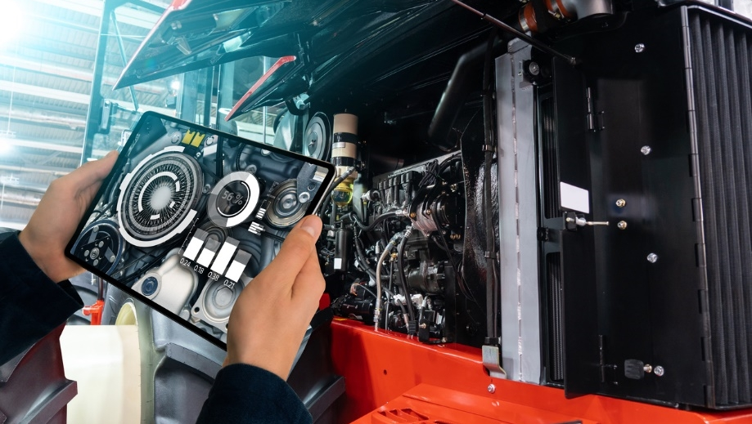
HIGH SCHOOL + SKILLED TRADE
Earn up to 8 credits.
Get paid while you learn.

Slide 13
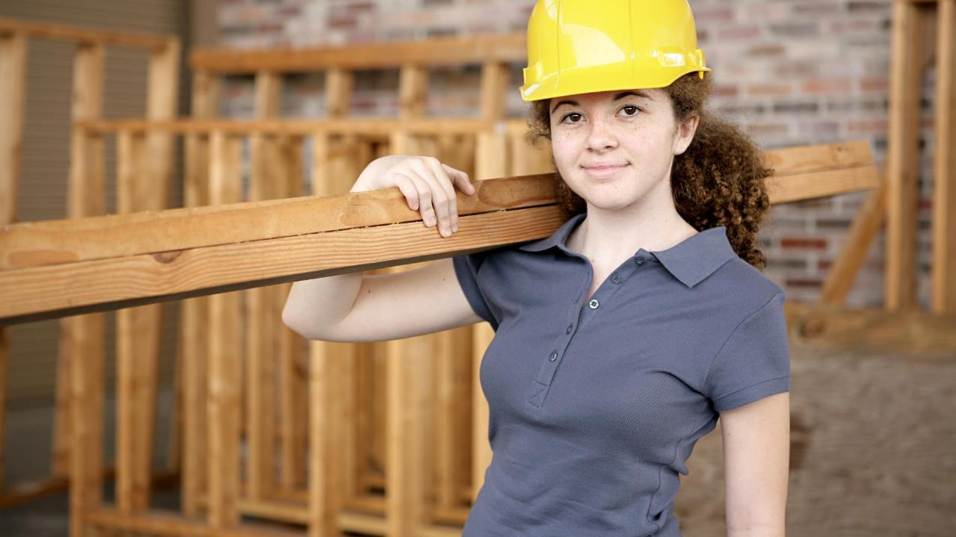
STUDENT — APPRENTICE
1 credit per 110 hours
Maximum 8 credits
$ hourly wage
Level 1 on-the-job hours

Slide 14
LEARN WHILE
YOU EARN.
Minimum 10% above
minimum wage.

Slide 15
PURSUE ADVANCEMENT OPPORTUNITIES.

Slide 16
WORK OUTDOORS.

Slide 17
BE PART OF
A TEAM.

Slide 18
GAIN A SENSE OF ACCOMPLISHMENT

Slide 19
BUILD YOUR FUTURE.

Slide 20
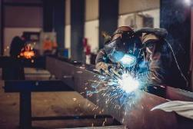
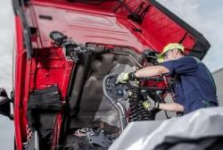
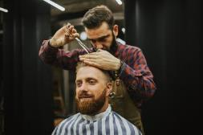
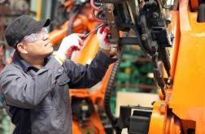
Manitoba has over 55 trades.
Welder Machinist Truck & Transport Mechanic Hairstylist
Bricklayer Carpenter Heavy Duty Equipment Technician Cook
https://www.gov.mb.ca/wd/apprenticeship/discover/mbtrades/index.html

Slide 21
Alternative Pathways to a Trades Career
Technical- Vocational Education (TVE) (non-accredited) | Technical- Vocational Education (accredited) | High School Apprenticeship Program (HSAP) | TVE (accredited) + HSAP

Slide 22
First Steps
Meet with an HSAP educator.
Secure a job with a qualified, insured employer.
Sign an Apprenticeship Application and Agreement with employer and Apprenticeship Manitoba (parent/guardian signature required if under 18).
STUDENT-APPRENTICESHIP

Slide 23
Contact Apprenticeship Manitoba to indicate whether you are
continuing your apprenticeship
ending your apprenticeship
Financial support for training
Every two credits (220 on-the-job hours) of apprenticeship qualify you for financial support (maximum 880 hours).
AFTER GRADUATION

Slide 24
Discover Your Trade
2–4 years to complete most trades
80% on-the-job training
20% classroom training

Slide 25
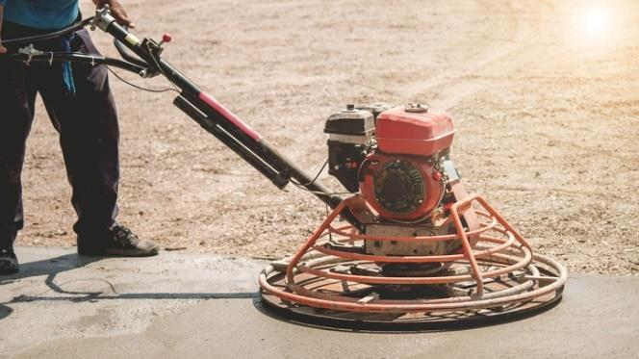
GET FINANCIAL
SUPPORT.
Tuition exemption earned
for on-the-job hours.

Slide 26
JOURNEYPERSON A holder of a Certificate of Qualification in a designated trade.

Slide 27
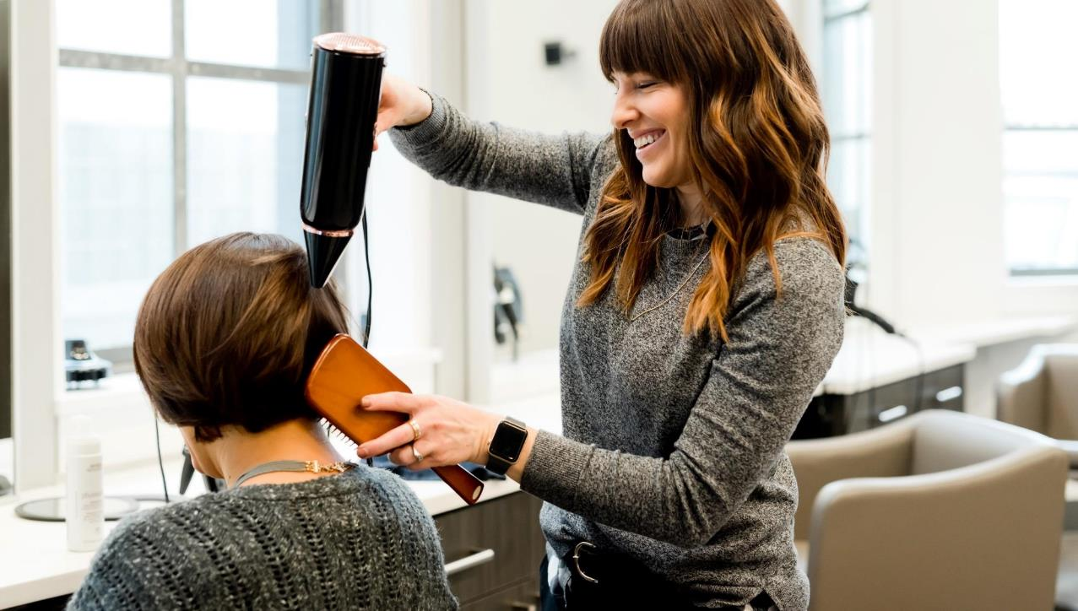
OWN
YOUR OWN BUSINESS.

Slide 28
Journeyperson Hourly Wages
Bricklayer | $34.20
Carpenter | $29.80
Concrete finisher | $25.75
Construction electrician | $35.25
Floor covering installer | $27.40
Industrial mechanic (millwright) | $32.55
Roofer | $28.25
Sprinkler system installer | $37.80
JOURNEYPERSON HOURLY WAGES
https://www.gov.mb.ca/labour/standards/doc,ici-wage,factsheet.html

Slide 29
Construction electrician
Crane operator
Mobile crane operator
Boom truck hoist operator
Tower crane operator
Industrial electrician
Refrigeration and air conditioning mechanic
Sprinkler system installer
Steamfitter-pipefitter
Electrologist
Esthetician
Hairstylist
COMPULSORY TRADES*
* Require Registered Apprenticeship Agreement OR Certificate of Qualification

Slide 30
VOLUNTARY TRADES Do not require a Certification of Qualification to work in Manitoba.

Slide 31
A RED SEAL endorsement indicates the holder has met the national standards in the trade, allowing tradespersons to be recognized and work across Canada.

Slide 32
RED SEAL TRADES IN CANADA
Agricultural Equipment Technician
Appliance Service Technician
Auto Body and Collision Technician
Automotive Refinishing Technician
Automotive Service Technician
Baker
Boilermaker
Bricklayer
Cabinetmaker
Carpenter
Concrete Finisher
Construction Craft Worker
Construction Electrician
Cook
Drywall Finisher and Plasterer
Electric Motor System Technician
Floorcovering Installer
Gasfitter — Class A
Gasfitter — Class B
Glazier
Hairstylist
Heavy Duty Equipment Technician
Heavy Equipment Operator (Dozer)
Heavy Equipment Operator (Excavator)
Heavy Equipment Operator (Tractor-Loader-Backhoe)
Industrial Electrician
Industrial Mechanic (Millwright)
Instrumentation and Control Technician
Insulator (Heat and Frost)
Ironworker (Generalist)
Ironworker (Reinforcing)
Ironworker (Structural/Ornamental)
Landscape Horticulturist
Lather (Interior Systems Mechanic)
Machinist
Metal Fabricator (Fitter)
Mobile Crane Operator
Motorcycle Technician
Oil Heat System Technician
Painter and Decorator
Parts Technician
Plumber
Powerline Technician
Recreation Vehicle Service Technician
Refrigeration and Air Conditioning Mechanic
Roofer
Sheet Metal Worker
Sprinkler Fitter
Steamfitter/Pipefitter
Tilesetter
Tool and Die Maker
Tower Crane Operator
Transport Trailer Technician
Truck and Transport Mechanic
Welder
https://www.red-seal.ca/eng/trades/tr.1d.2s_l.3st.shtml

Slide 33
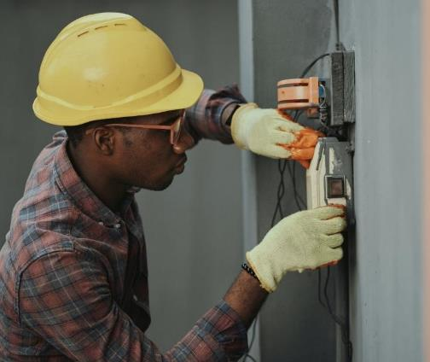
Apprenticeship Training Example:
CONSTRUCTION ELECTRICIAN
Apprenticeship Annual Requirements
Levels | Total Hours/Year (On-the-Job & Technical Training) | Total Weeks/Year (Technical Training) | Delivered By
4 | 1800 | 10-10-10-10 | RRC & ACC (All levels) UCN (Levels 1 & 2 only)
https://www.gov.mb.ca/wd/apprenticeship/discover/mbtrades/constructionelectrician.html

Slide 34
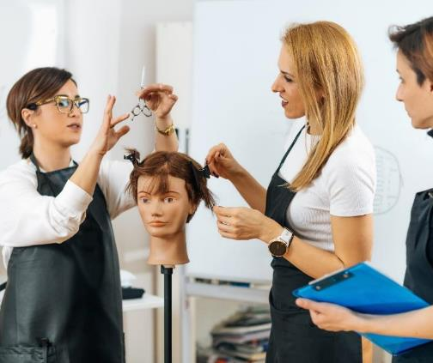
Apprenticeship Training Example:
HAIRSTYLIST
Apprenticeship Annual Requirements
Levels | Total Hours/Year (On-the-Job & Technical Training) | Total Weeks/Year (Technical Training) | Delivered By
2 | 3000 (1500 each level) | 1400 hours (Level 1 only) | Various Accredited Programs
https://www.gov.mb.ca/wd/apprenticeship/discover/mbtrades/hairstylist.html

Slide 35
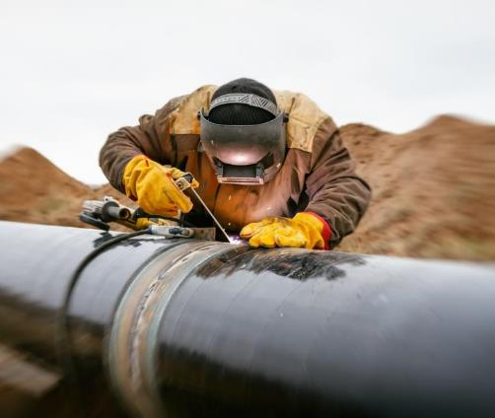
Apprenticeship Training Example:
WELDER
Apprenticeship Annual Requirements
Levels | Total Hours/Year (On-the-Job & Technical Training) | Total Weeks/Year (Technical Training) | Delivered By
3 | 1800 | 8-8-8 | ACC
https://www.gov.mb.ca/wd/apprenticeship/discover/mbtrades/welder.html

Slide 36
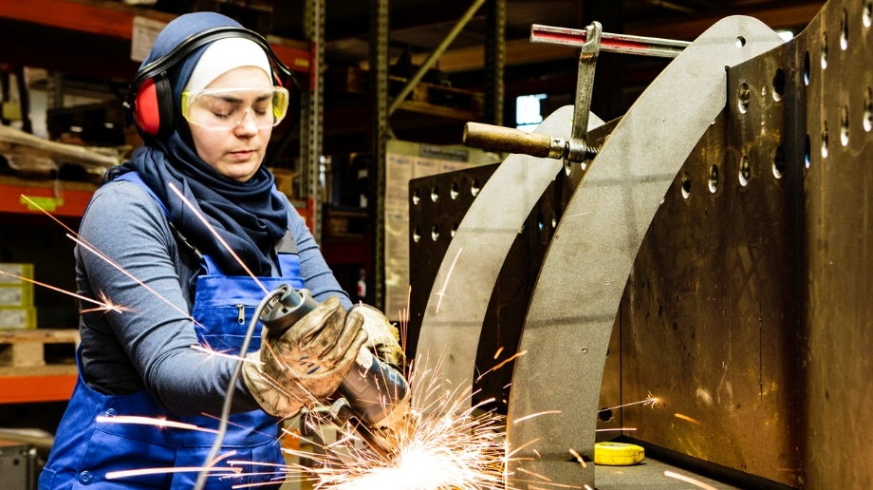
The OFFICE TO ADVANCE WOMEN APPRENTICES MANITOBA was created to engage and support tradeswomen working in construction trades.

